Slide 1

Traffic Flow Optimization: A Predictive Approach
This project introduces a predictive traffic flow optimization system designed to forecast congestion and recommend routes that enhance city-wide traffic patterns. Unlike traditional navigation apps, our system leverages machine learning to anticipate traffic, offering proactive solutions for both individual drivers and urban planners to reduce emissions and commute times.
Our approach differentiates itself through predictive power using LSTM/Graph Neural Networks, multi-objective optimization balancing individual and city-wide efficiency, and an innovative data pipeline integrating open datasets and traffic simulations. We aim to provide a foundational solution for smarter urban mobility.

Slide 2
Technical Approach and Output
Model Development
Data Engineering
Developed LSTM and Graph Neural Networks (GNNs) to predict congestion and traffic flow, achieving 12% lower MAE than ARIMA baselines.
Cleaned and processed historical traffic data (NYC Taxi, 10M+ rows) and external factors (weather, events), mapping GPS to road segments and creating lag features.
Deployment
Optimization & Simulation
Built a Flask API for optimized routes and visualized predictions with congestion heatmaps on Folium maps.
Implemented a modified A* algorithm with traffic-weighted costs and used SUMO for simulations, demonstrating 18% fewer traffic jams.
Model Outputs
The ML model predicts hourly traffic volume (e.g., "Road A: 1,200 vehicles/hour at 5 PM"), congestion levels (e.g., "Downtown area: 85% probability of severe congestion at 6 PM"), and average speeds. These predictions feed into an optimization engine that generates optimal routes for drivers (e.g., "18 mins vs. 30 mins on default route") and provides heatmaps for city planners to redistribute traffic.

Slide 3
Visualizing and Impacting Urban Mobility
Visualizing the Output
Why This Output Matters
Interactive Maps: Folium/Plotly for congestion hotspots.
Drivers: Save time, fuel, and reduce stress.
Cities: Cut emissions, improve safety, aid infrastructure planning.
Web/Mobile Apps: Displaying predictive routes.
Dashboards: For city planners to monitor trends.
Businesses: Optimize logistics and delivery routes.
This project develops a predictive traffic flow optimization system using machine learning to forecast urban congestion. By analyzing historical data and real-time factors, it predicts traffic volume and speed using LSTM models. A route optimization engine balances individual travel time and city-wide efficiency with graph-based algorithms. The system, deployed as a web application with interactive maps, addresses urban traffic challenges, reduces emissions, and improves commute efficiency.

Slide 4
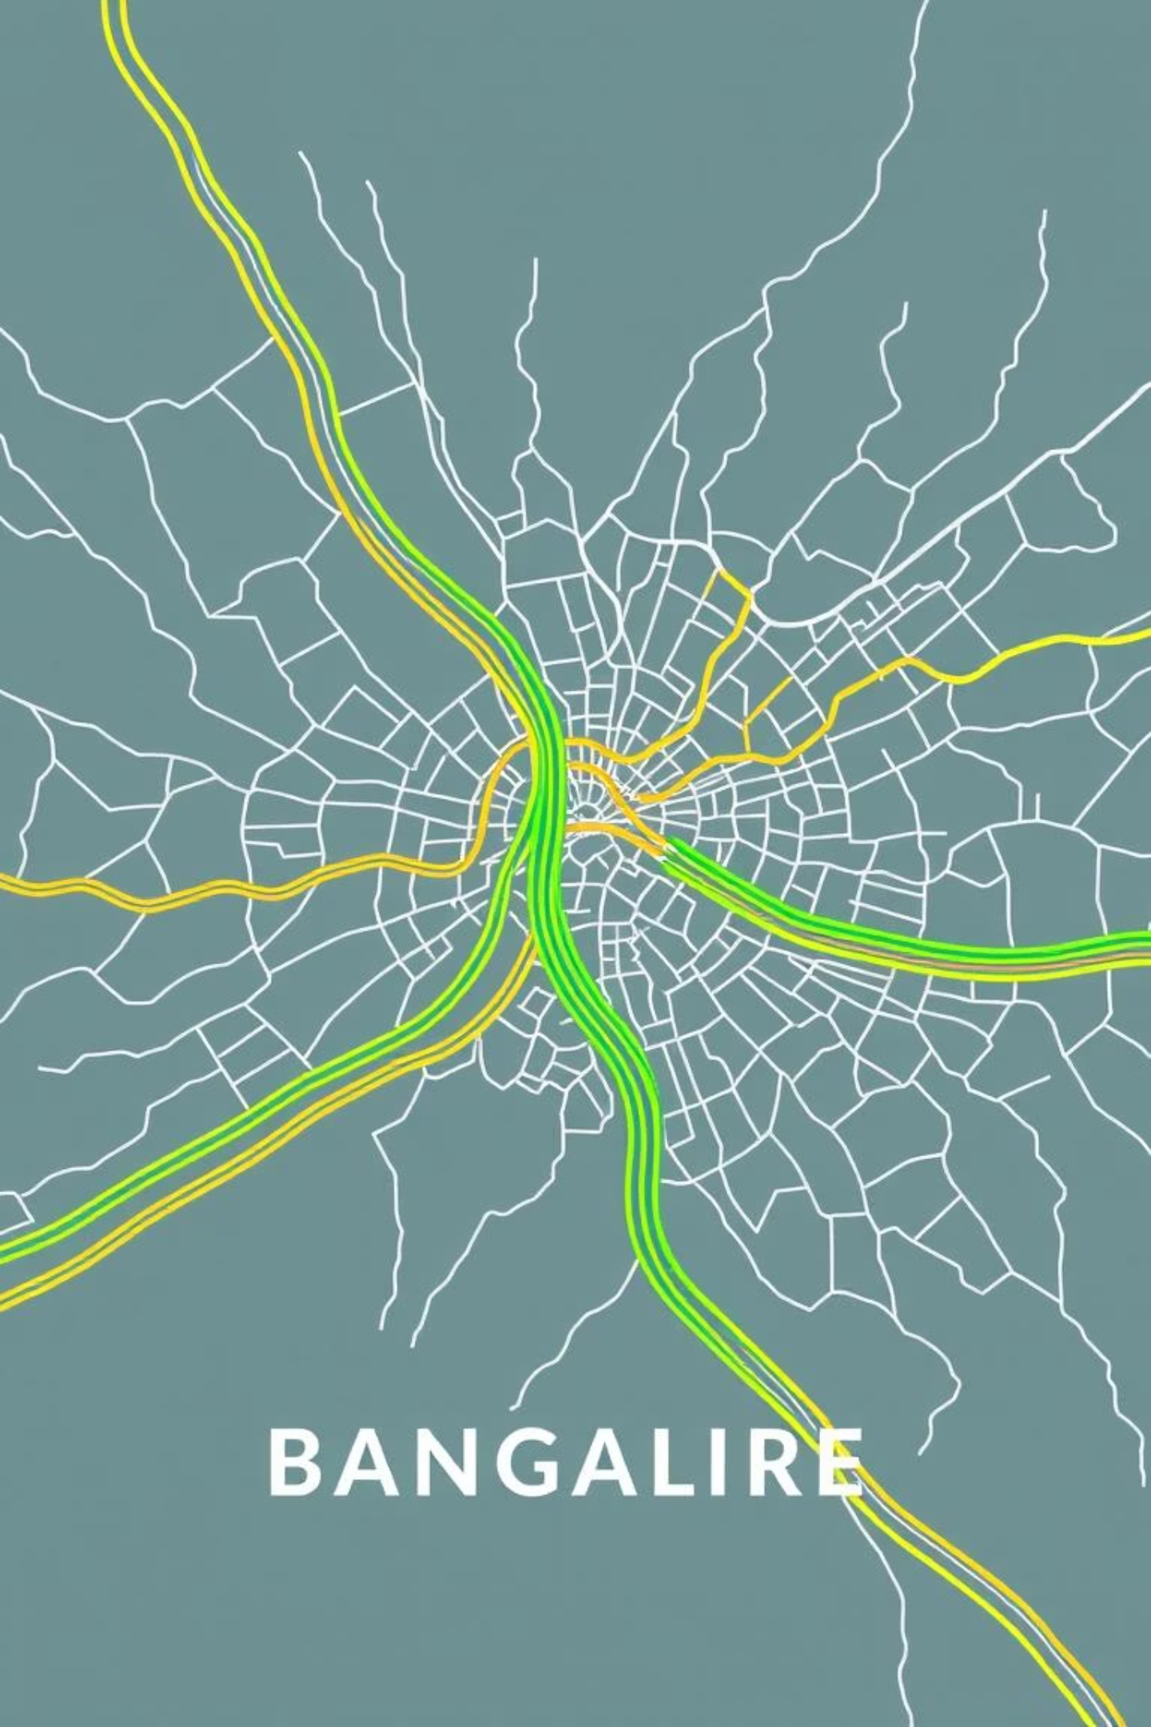
Project Outcomes and Dataset Overview
Expected Outcome (End of 5th Sem)
Bangalore Traffic Dataset
This dataset contains 8,936 records across 16 columns, ideal for traffic flow optimization. Key numerical stats include Traffic Volume (4,233-72,039 vehicles), Average Speed (20-90 km/h), and Congestion Level (often 100%). Categorical features cover 8 Area Names, 16 Road/Intersection Names, 5 Weather Conditions, and Roadwork Activity.
Trained ML model with >85% accuracy in predicting hourly traffic volume.
Functional web application (Flask API) for route optimization and congestion visualization.
Simulation results (SUMO) showing 15–20% reduction in average commute time.
Comprehensive documentation and a research paper.

